Slide 1
School of Information Technology
ICT302
Information Technology Professional Practice Project
ITP3
Requirements and Analysis

Slide 2
Acknowledgement
of Country
Requirements and Analysis
We acknowledge that Murdoch University is situated on the lands of the Whadjuk and Binjareb Noongar people.
We pay our respect to their enduring and dynamic culture and the leadership of Noongar elders past and present.
The boodjar (country) on which Murdoch University is located has for thousands of years, been a place of learning. We at Murdoch University are proud to continue this long tradition.
Notes:
South Street
We acknowledge that Murdoch University is situated on the lands of the Whadjuk and Binjareb Noongar people.
We pay our respect to their enduring and dynamic culture and the leadership of Noongar elders past and present.
The boodjar (country) on which Murdoch University is located has for thousands of years, been a place of learning. We at Murdoch University are proud to continue this long tradition.

Slide 3
Objectives
Understand why we do Requirements and Analysis
Requirements Elicitation
Processing Information
The Requirements and Analysis document
Determining
Functional Requirements
Non-Functional Requirements
Deciding on a methodology
Using Diagrammatic Representations

Slide 4
Why We Produce a Requirements and Analysis Document?
We do not perform it just because it’s a deliverable for this unit!
During the Requirements & Analysis (R&A) process the domain and SCOPE of the system are discovered, tasks are documented, and elements are conceptualised
It is the guide / plan that your developers will follow:
It tells them what they need to build to meet the clients needs

Slide 5
Why We Produce a Requirements and Analysis Document?
It is a really important step in ensuring that the software solution that you produce is:
Of high quality (stable, secure etc)
Meets your clients’ needs - you can be assured that the product is what the client actually wants (not just what you think the client wants), and the client can be assured that the product will actually do what they want it to do

Slide 6
What Information is Required to Produce a R&A Document?
Understanding of the business
Understanding of how your system will fit in with existing systems (scope of the project, target audience, etc)
What the client requires the system to do (functional and non-functional requirements)
How important each of the functional requirements are (since you probably cannot implement all of them)

Slide 7
What Information is Required to Produce a R&A Document?
How long it is going to take to implement these functional requirements
The constraints placed on the system by the client
An estimate of the time required to implement the system and an estimate of the time you are willing to allocate
An understanding of the methodology to use for designing and implementing the system

Slide 8
Where does the Information come from?
The Client
Your client knows their business best, so you need to source a lot of information from them:
Context
Background information about their business
Current system they have
The problems they are encountering and want you are to help with
Overall what they want the system you are building to do
Who will be using the system – target audience etc
Any constraints on the system

Slide 9
Where does the Information come from?
Your Team
You are the IT Professionals, you understand the technical side of things that your client may not!
It is your job to process and analyse the information the client gives you and then negotiate the system you are going to build for them

Slide 10
Where does the Information come from?
Work closely with your client
Make sure you understand what they really require, don’t assume that you know what they need – check back with them!

Slide 11
Requirements Elicitation Techniques
Getting Information from your Client:
Sampling of existing documentation,
forms and databases
Interviews
Questionnaires
Observation
Prototyping

Slide 12
1. Existing Documentation, Forms and Databases
If you are working with an existing system, then you will need to be able to look at the existing documents / databases
Even if you are constructing a ‘new’ system there are more than likely existing documentation
Your client will probably provide you with these or a sample of these if you ask

Slide 13
1. Existing Documentation, Forms and Databases
Remember some of this information may be confidential so take note of your client wishes with regard to none disclosure, etc
Examine the existing documentation before interviewing company personal:
Organisational charts
Documents describing the problem
Documents describing the business function being investigated
Previous system documentation

Slide 14
2. Points on Interviewing your Client
It should not really be that hard!
Remember to keep on track though
Have a plan for the meeting
Know what you need to get out of it
Check off the goals as you go!
Interview Question Guidelines
Use clear and concise language
Don’t include your opinion as part of the question
Avoid long or complex questions
Avoid threatening questions
Don’t use “you” when you mean a group of people

Slide 15
3. Questionnaires
Are a great source of information BUT
They take time to prepare
Time for the participants to fill them in
Time to process
You may not get many back
So…..if you do make a questionnaire keep it short and to the point

Slide 16
4. Observation
Observation is a fact-finding technique wherein the systems analyst either participates in or watches a person perform activities to learn about the system
Advantages:
Accurate source of information by direct observation
Disadvantages:
Time (and thus cost) involved
Mis-leading performance of activities
Notes:
16

Slide 17
5. Prototyping
Good way to get feedback from your client
But can be time consuming and you still need basic requirements before you start prototyping

Slide 18
Processing the Information
In Systems Analysis and Design you learned several techniques:
Problem summary
Ishikawa diagram (fishbone diagram / cause and effect)
Problems, opportunities, objectives and constraints matrix
Let’s jog the memory!

Slide 19
Deciding on a Methodology
Every group needs to follow a methodology EVEN if its not a formal one
Methodologies cover:
models to be developed
tools to be used – i.e. software support for creating models and / or creating components in the system
techniques – guidelines on how to complete a development task or activity

Slide 20
Deciding on a Methodology
There are lots of methodologies
It is up to you to decide on which methodology to use, but you must follow some sort of process – you cannot just develop a project in an ad-hoc fashion
Regardless of the methodology you use, you MUST describe and document the process you follow!

Slide 21
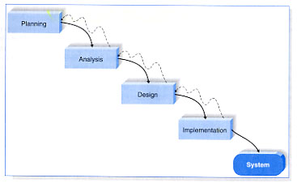
Waterfall Methodologies: (Structured such as SDLC)
Notes:
21

Slide 22
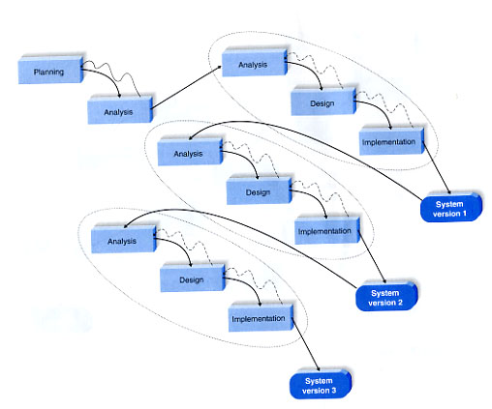
Phased Methodologies: Rapid Application Development (RAD)

Slide 23
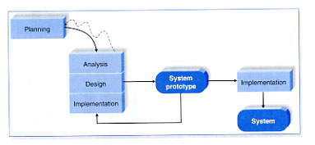
Prototyping Methodologies: (RAD – product driven)

Slide 24
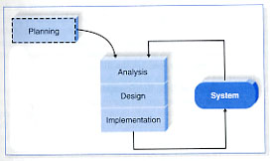
Agile Methodologies: (XP, Scrum, ...)

Slide 25
Deciding on a Methodology
So you not only have to decide upon the methodology to use, but also about the information you need to build a system?

Slide 26
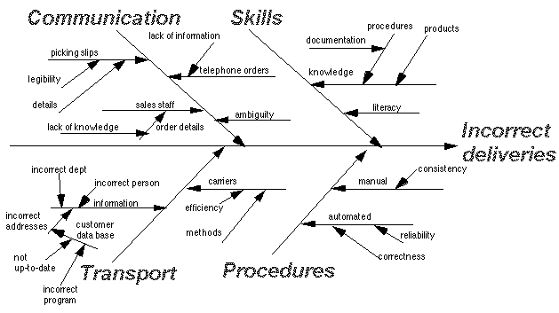
Ishikawa Diagram

Slide 27
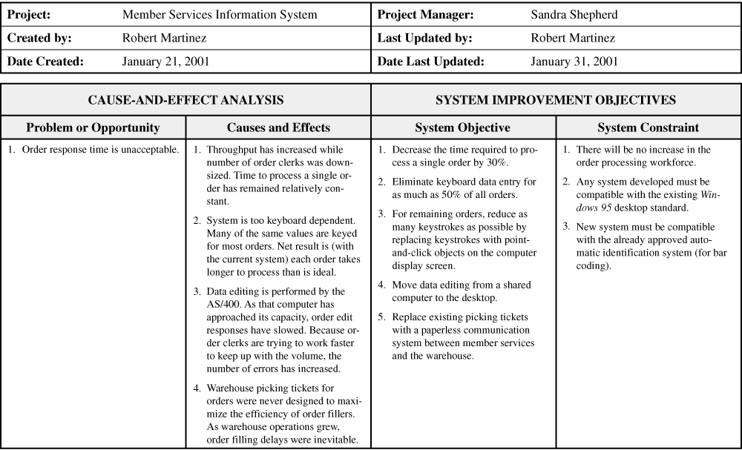
Problem Matrix

Slide 28
Lets write it up
Your R&A outline for ICT302 suggests:
Written outline of your solution
AND
Diagrammatic representation (models)

Slide 29
Preliminaries
Required for all group deliverables:
Cover page
Title page
project name, name of the client organization, name of the group and possibly the names of group members, date of the document, version of the document
Table of contents

Slide 30
Preliminaries
Executive summary
Purpose of the document
A summary of the whole document
What is presented in each section

Slide 31
Introduction
Purpose of the project
Discuss the unit, the team and the reasons why your client wants the product developed
The background to the client’s business and organization
Narrative outline of the current system if applicable, the system to be created, and how the newly created system will be incorporated into the existing system

Slide 32
Introduction
Problems and Opportunities
The basic problem(s) that needs solving
The opportunities afforded by solving the problem(s)
The objectives and goals of the system, deisgn or consultation document that will be produced
Brief discussion of the methodology and why that particular methodology was chosen

Slide 33
Narrative of the Proposed Solution
Scope definition
Narrative description of proposed system
The system functionality
A description of the interface through which the user will access that functionality
The output expected from the system
Any constraints imposed on the system
The hardware / software and other computing environments to be used in the solution

Slide 34
The List of Requirements
What are requirements?
Precise statement of required functionality, conveying understanding about the desired end result – i.e. functional requirements:
Specifically what tasks the system needs to perform to satisfy the business need and be acceptable to the users
As requirements form the basis for work packages defined in the Work Breakdown Structure (WBS), it is important to
document them to a relevant level of detail

Slide 35
Functional Requirements in your R&A
For each requirement there is a fair bit of information you need to think about
A full description of the requirement
Criticality – eg: the system won’t function without it
Priority that the user has given it
Describe how essential this requirement is to the overall system

Slide 36
Functional Requirements in your R&A
Technical issues
Describe any design or implementation issues involved in satisfying this requirement
Cost and schedule
Describe the relative or absolute costs associated with this issue
For your student project, cost is generally going to be in terms of your time

Slide 37
Functional Requirements in your R&A
Risks
Describe the circumstances under which this requirement might not be able to be satisfied, and what actions can be taken to reduce the probability of this occurrence
Dependencies with other requirements
This means any interactions with other requirements, such as one depends on another, or they both use the same function for something
Note: not all of these considerations will apply in this unit, so they may not require expansive sections. However, some will!!!

Slide 38
Getting the Value
List functional requirements in order of the client’s priority
You could use the $100 test!

Slide 39
What is it?
A quick and easy method of getting your client to indicate the importance they place on a requirement
We use money as its something most people are used to thinking about!
This will show you the relative values of each requirement
You can see how much more important one requirement is than another so you will know where your time is best spent!

Slide 40
How to use it
Develop the list of your requirements
with the client
Go back to the client with the final list of
requirements
Tell them that they have $100 to divide
over the requirements
The way that they spend the $100
indicates the priority that they put on
each requirement

Slide 41
How to use it
Requirement | Value
Authentication System | $20
Database | $40
GUI | $20
Web access | $15
Command line access | $5

Slide 42
R&A: Non–functional Requirements
Documentation
What documentation is required?
What audience is to be addressed by each document?
Hardware Consideration
What hardware is the proposed system to be used on?
What are the characteristics of the target hardware, including memory size and auxiliary storage space?

Slide 43
R&A: Non–functional Requirements
Performance Characteristics
Are there any speed, throughput, or response time constraints on the system?
Are there size or capacity constraints on the data to be processed by the system?
Error Handling and Extreme Conditions
How should the system respond to input errors?
How should the system respond to extreme conditions?

Slide 44
R&A: Non–functional Requirements
System Interfacing and Compatibility
Think about the I/O of your subsystem
Is input coming from systems outside the proposed system?
Is output going to systems outside the proposed system?
Are there restrictions on the format or medium that must be used for input or output?

Slide 45
R&A: Non–functional Requirements
Quality Issues
What are the requirements for reliability?
Must the system trap faults?
Is there a maximum acceptable time for restarting the system after a failure?
What is the acceptable system downtime per 24-hour period?
Is it important that the system be portable (able to move to different hardware or operating system environments)?

Slide 46
R&A: Non–functional Requirements
System Modifications
What parts of the system are likely candidates for later modification?
What sorts of modifications may be expected?
Physical Environment
Where will the target equipment operate?
Will the target equipment be in one or several locations?
Will the environmental conditions in any way be out of the ordinary (for example, unusual temperatures, vibrations, magnetic fields, ...)?

Slide 47
R&A: Non–functional Requirements
Security Issues
Focus on all possible security considerations
Must access to any data or the system itself be controlled?
Is physical security an issue?
Resource Issues
How often will the system be backed up?
Who will be responsible for the back up?
Who is responsible for system installation?
Who will be responsible for system maintenance?

Slide 48
Why Diagrams?
A written outline may not convey sufficient detail to provide a complete analysis
The group needs to decide on the most appropriate models for specifying the system
Diagrammatic representation (models) could include:
Use Case model diagrams / Use Case narratives
Data flow diagrams / decomposition diagrams
Entity relationship diagrams
Class diagrams
Activity diagrams / state diagrams
Network diagrams

Slide 49
Use Case model
Use Case Diagrams (UCDs) can be used to describe the functionality of a system
A use case represents a single goal of a system and describes a sequence of activities and user interaction in trying to accomplish the goal
They do not represent the order or number of times that the systems actions and sub-actions should be executed
UCDs have only 4 major elements:
the actors that the system interacts with
the system itself
the use cases, or services, that the system knows how to perform
the lines that represent relationships between these elements

Slide 50
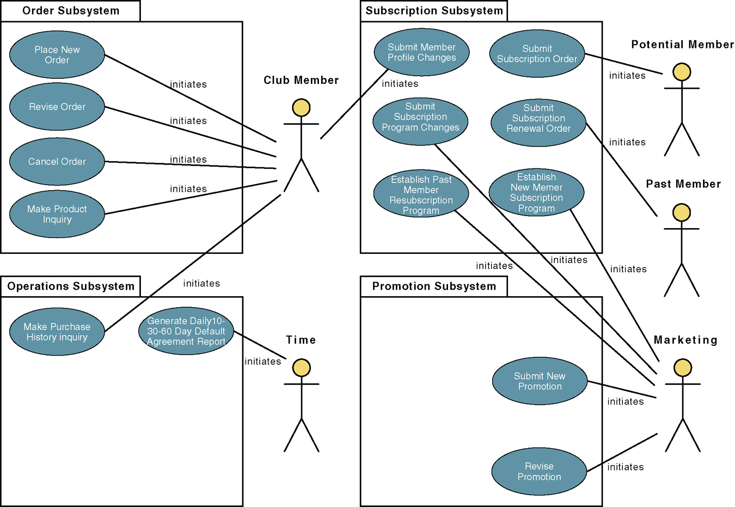
Use Case Model
system
actor
use case
relationship

Slide 51
Data Flow Diagram (DFD)
Graphical representation of the "flow" of data through an information system
Used for the visualization of data processing
Designers often draw a context-level DFD first which shows the interaction between the system and outside entities
This context-level DFD is then "exploded" to show more detail of the system being modeled

Slide 52
Data Flow Diagram (DFD)
The four components of a data flow diagram (DFD) are:
External Entities/Terminators/Sources/Sinks (represented by a square or oval)
Processes (represented by a circle or rounded rectangle)
Data Flows (represented by an arrow)
Data Stores (represented by two parallel lines, sometimes connected by a vertical line)
NOTE – Consistency between levels is important. Don’t gain or lose data flows, data stores or external agents between levels

Slide 53
Data Flow Diagram (DFD)
DFD for one use case
External Entity
Data flow
Process
Data store

Slide 54
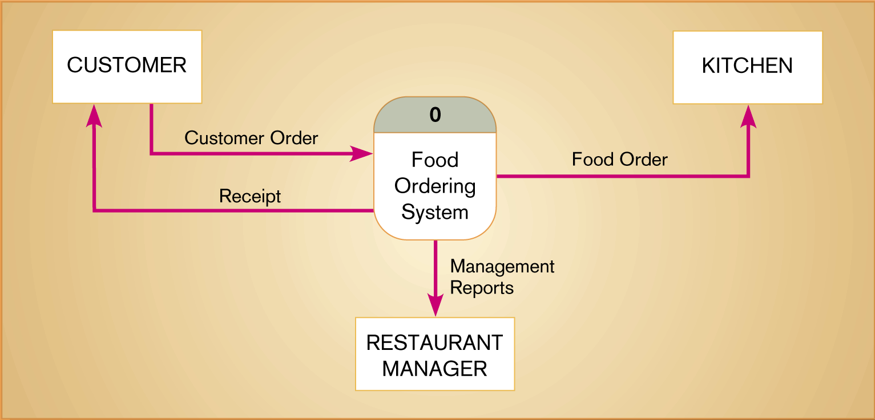
Context DFD

Slide 55
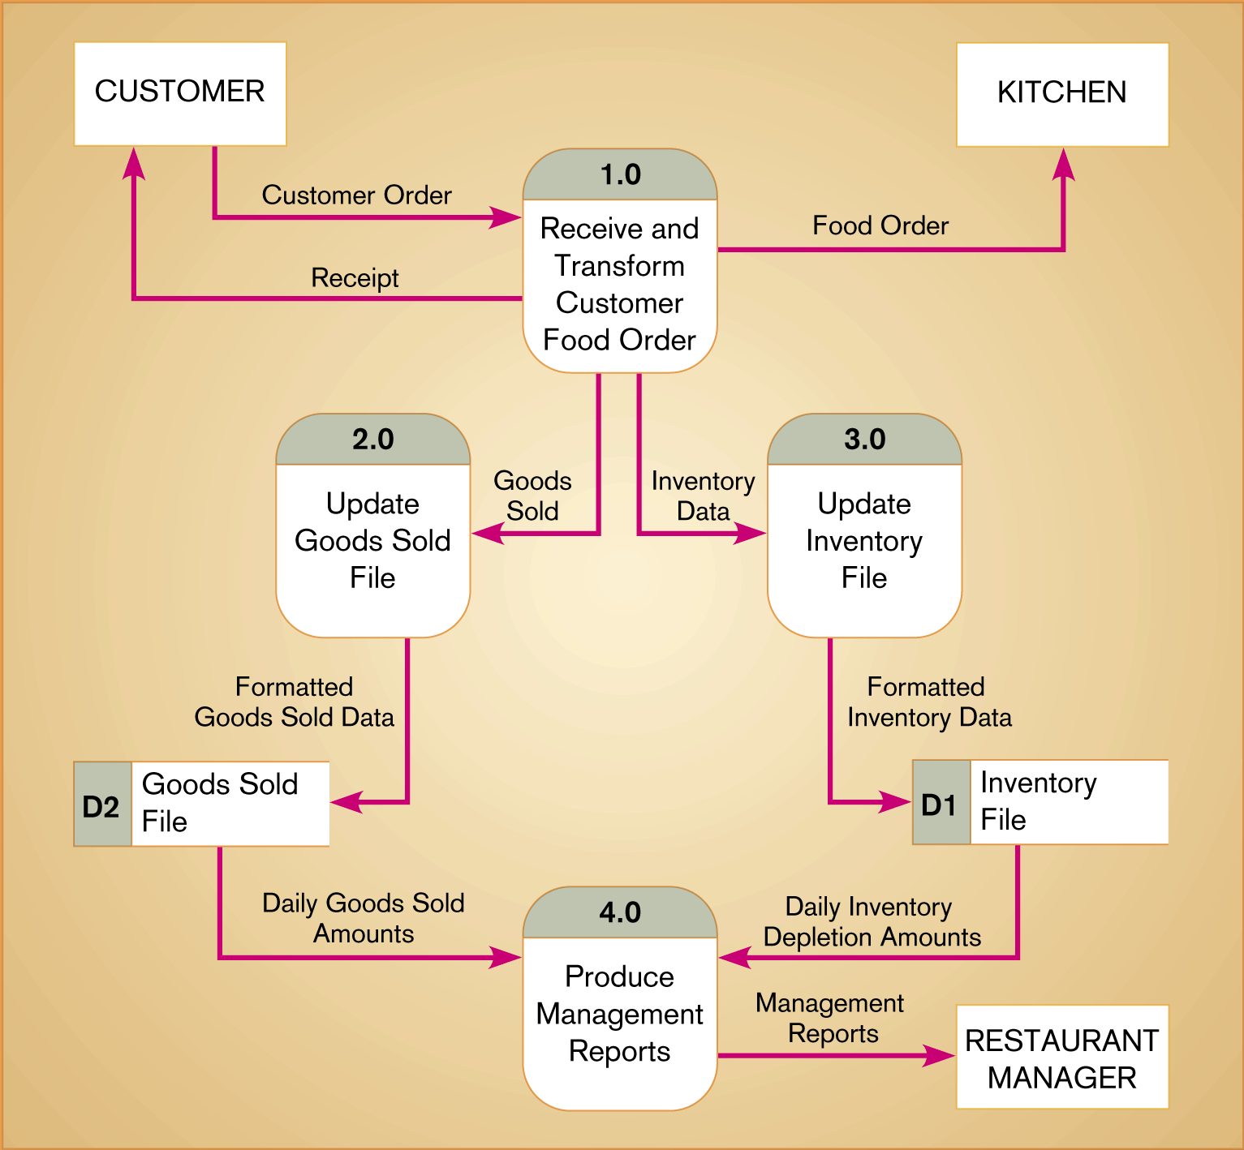
Example Level 0 DFD
Notes:
55

Slide 56
Structured English Example
1. For each CUSTOMER NUMBER in the data store CUSTOMERS:
a. For each LOAN in the data store LOANS that matches the above
CUSTOMER NUMBER:
1) Keep a running total of NUMBER OF LOANS for the
CUSTOMER NUMBER.
2) Keep a running total of the ORIGINAL LOAN PRINCIPAL for the
CUSTOMER NUMBER.
3) Keep a running total of CURRENT LOAN BALANCE for the
CUSTOMER NUMBER.
4) Keep a running total of AMOUNTS PAST DUE for the
CUSTOMER NUMBER.
b. If the TOTAL AMOUNTS PAST DUE for the CUSTOMER NUMBER
is greater than $100.00 then:
1) Write the CUSTOMER NUMBER and all their data attributes
as described in the data flow LOANS AT RISK.
Else
1) Exclude the CUSTOMER NUMBER and data from the data
flow LOANS AT RISK.
Notes:
56

Slide 57
Decomposition Diagram
A decomposition diagram or hierarchy chart shows the top-down, functional decomposition of a system
Decomposition diagrams may represent organizational structure or functional decomposition into processes
The parent block is at the top of the decomposition diagram, and it is composed of child blocks
A decomposition diagram does not show order of execution or dependency between blocks
It also does not show flow between blocks

Slide 58
Decomposition Diagram
parent
child

Slide 59
Entity Relationship Diagram (ERD)
Entity Relationship Diagrams are a major data modeling tool and will help organize the data in your project into entities and define the relationships between the entities
This process has proved to enable the analyst to produce a good database structure so that the data can be stored and retrieved in a most efficient manner

Slide 60
Entity Relationship Diagram (ERD)
Comprised of:
Entity - anything real or abstract about which we want to store data. Entity types fall into five categories: roles, events, locations, tangible things or concepts. e.g. customer, job, job material, job charge
Relationship - a natural association that exists between one or more entities. e.g. job has a job material
Cardinality defines the number of occurrences of one entity for a single occurrence of the related entity. e.g. a job may have 0,1 or many job materials

Slide 61
Entity Relationship Diagram (ERD)
Comprised of:
Attribute - a characteristic common to all or most instances of a particular entity. e.g. Name, Address, Employee Number, Pay Rate are all attributes of the entity employee
An attribute or combination of attributes that uniquely identifies one and only one instance of an entity is called a primary key or identifier. E.g. Customer has CustomerID (PK)

Slide 62
Entity Relationship Diagram (ERD)
entity
relationship
attribute
cardinality
Primary key

Slide 63
CRUD Matrix
A CRUD matrix is a table showing the functions in an application containing SQL statements affecting parts of a database
SQL consists of only 4 statements, sometimes referred to as CRUD:
Create - INSERT - to store new data
Read - SELECT - to retrieve data
Update - UPDATE - to change or modify data
Delete - DELETE - delete or remove data

Slide 64
CRUD Matrix
The CRUD Matrix identifies the Tables involved in any CRUD operation
The analysis helps to identify any Tables which are not used, and any Tables which are used heavily, and may therefore be a performance bottleneck

Slide 65
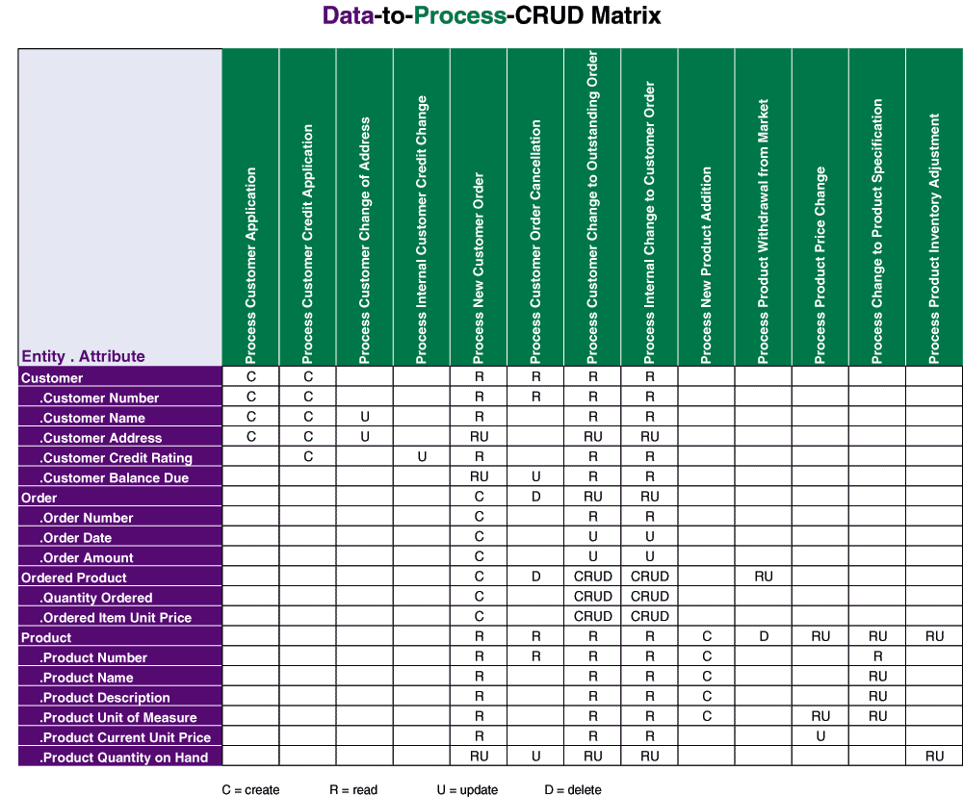
Example Data to Process CRUD Matrix

Slide 66
Class Diagram
Shows the classes of the system, their inter-relationships, and the operations and attributes of the classes
Class diagrams are typically used, although not all at once, to:
Explore domain concepts in the form of a domain model
Analyse requirements in the form of a conceptual / analysis model
Depict the detailed design of object-oriented or object-based software

Slide 67
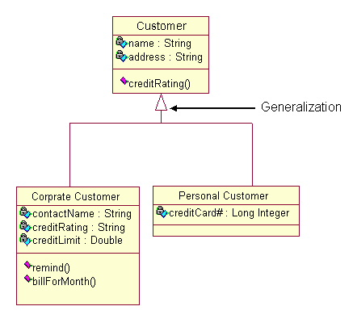
Example Class Diagram

Slide 68
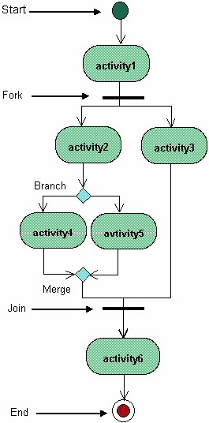
Activity Diagram
Activity diagrams represent the business and operational work-flows of a system
An Activity Diagram shows the overall flow of control

Slide 69
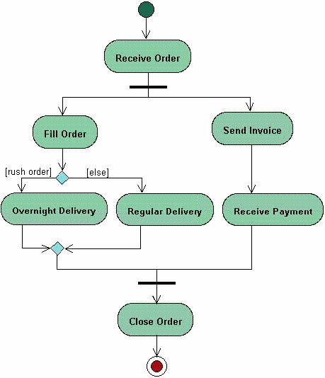
Example Activity Diagram

Slide 70
State Transition Diagram
Shows:
the state space of a given context
the events that cause a transition from one state to another
the actions that result

Slide 71
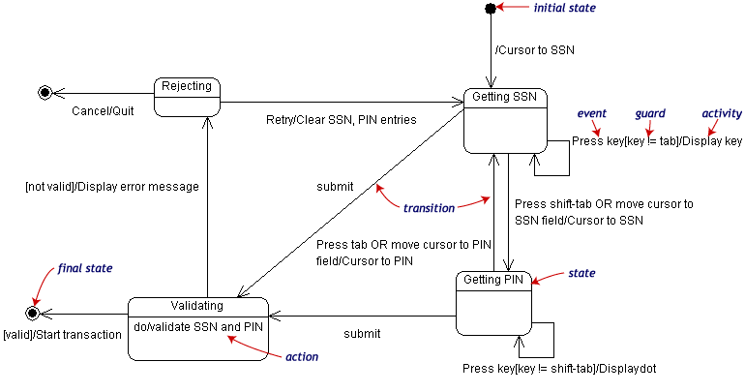
Example State Transition Diagram

Slide 72
Network Activity Diagram
Hardware available
General connections
Possible paths of flow

Slide 73
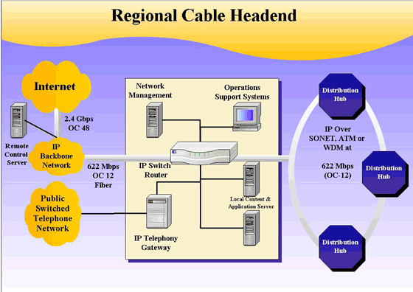
Example Network Diagram

Slide 74
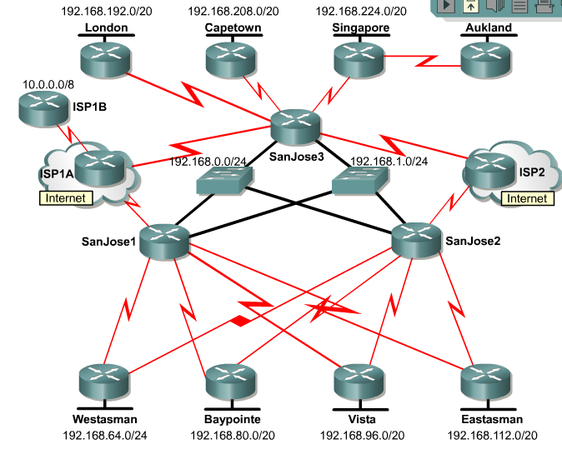
Example Network Diagram

Slide 75
Conclusion
Restate the purpose of the document
Summarise what the document contains

Slide 76
Summary
What is the R&A
Methodologies available
Requirements Elicitation
The R&A document
Determining Value
Non-Functional Requirements
Using Diagrammatic Representations

Slide 77
Peter Cole
p.cole@Murdoch.edu.au
0417 097 914

